Slide 1
Chapter 17
How to work with file I/O

Slide 2
Objectives
Applied
Develop an application that requires the use of text or binary files.
Knowledge
Distinguish between a text file and a binary file.
Describe the use of FileStream, StreamReader, StreamWriter, BinaryReader, and BinaryWriter objects.
Describe two common types of I/O exceptions.
Distinguish between a using statement and a using declaration.

Slide 3
System.IO classes used to work with drives and directories
Directory
File
Path
A statement that simplifies references to the System.IO classes
using System.IO;

Slide 4
Common methods of the Directory class
Exists(path)
CreateDirectory(path)
Delete(path, recursive)
Code that uses some of the Directory methods
string dir = @"C:\C#\Files\";
if (!Directory.Exists(dir))
Directory.CreateDirectory(dir);

Slide 5
Common methods of the File class
Exists(path)
Delete(path)
Copy(source, dest)
Move(source, dest)
Code that uses some of the File methods
string path = dir + "Products.txt";
if (File.Exists(path))
File.Delete(path);

Slide 6
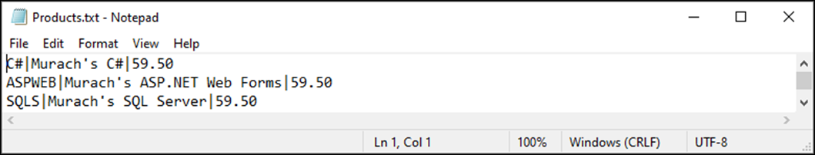
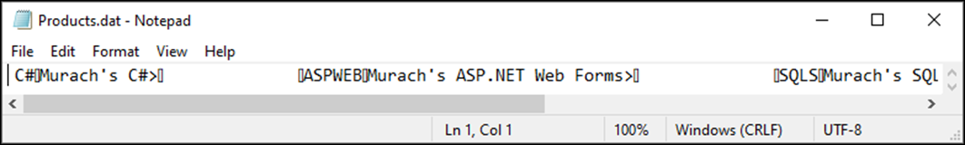
A text file displayed in a text editor
A binary file displayed in a text editor

Slide 7
Two types of files
Type Description
Text A file that contains text (string) characters. The fields in each record are typically delimited by special characters like tab or pipe characters, and the records are typically delimited by new line characters.
Binary A file that can contain a variety of data types.
Two types of streams
Stream Description
Text Used to transfer text data.
Binary Used to transfer binary data.

Slide 8
System.IO classes used to work with files and streams
Class Description
FileStream Provides access to input and output files.
StreamReader Used to read a stream of characters.
StreamWriter Used to write a stream of characters.
BinaryReader Used to read a stream of binary data.
BinaryWriter Used to write a stream of binary data.

Slide 9
The syntax for creating a FileStream object
new FileStream(path, mode[, access[, share]])
Members in the FileMode enumeration
Append
Create
CreateNew
Open
OpenOrCreate
Truncate

Slide 10
Members in the FileAccess enumeration
Read
ReadWrite
Write
Members in the FileShare enumeration
None
Read
ReadWrite
Write
Common method of the FileStream class
Close()

Slide 11
Code that creates a FileStream object for writing
string path = @"C:\C#\Files\Products.txt";
FileStream fs = new FileStream(
path, FileMode.Create, FileAccess.Write);
Code that creates a new FileStream object for reading
string path = @"C:\C#\Files\Products.txt";
FileStream fs = new FileStream(
path, FileMode.Open, FileAccess.Read);

Slide 12
The exception classes for file I/O
IOException
DirectoryNotFoundException
FileNotFoundException
EndOfStreamException

Slide 13
Code that uses exception classes (part 1)
string dirPath = @"C:\C#\Files\";
string filePath = dirPath + "Products.txt";
FileStream fs = null;
try
{
fs = new FileStream(filePath, FileMode.Open);
// code that uses the file stream
// to read and write data from the file
}
catch (FileNotFoundException)
{
MessageBox.Show(filePath + " not found.",
"File Not Found");
}
catch (DirectoryNotFoundException)
{
MessageBox.Show(dirPath + " not found.",
"Directory Not Found");
}

Slide 14
Code that uses exception classes (part 2)
catch (IOException ex)
{
MessageBox.Show(ex.Message, "IOException");
}
finally
{
if (fs != null)
fs.Close();
}

Slide 15
The basic syntax for creating a StreamWriter object
new StreamWriter(stream)
Common methods of the StreamWriter class
Method Description
Write(data) Writes the data to the output stream.
WriteLine(data) Writes the data to the output stream and appends a line terminator (usually a carriage return and a line feed).
Close() Closes the StreamWriter object and the associated FileStream object.

Slide 16
A method that writes data from a collection of Product objects to a text file
public static void SaveProducts(List<Product> products)
{
StreamWriter textOut =
new StreamWriter(
new FileStream( path, FileMode.Create, FileAccess.Write));
foreach (Product product in products)
{
textOut.Write(product.Code + "|");
textOut.Write(product.Description + "|");
textOut.WriteLine(product.Price);
}
textOut.Close();
}

Slide 17
The basic syntax for creating a StreamReader object
new StreamReader(stream)
Common methods of the StreamReader class
Method Description
Peek() Returns the next available character in the input stream without advancing to the next position. If no more characters are available, this method returns -1.
Read() Reads the next character from the input stream.
ReadLine() Reads the next line of characters from the input stream and returns it as a string.
ReadToEnd() Reads the data from the current position in the input stream to the end of the stream and returns it as a string.
Close() Closes both the StreamReader object and the associated FileStream object.

Slide 18
A method that reads data from a text file into a collection of Product objects
public static List<Product> GetProducts()
{
StreamReader textIn =
new StreamReader(
new FileStream(path, FileMode.OpenOrCreate,
FileAccess.Read));
List<Product> products = new List<Product>();
while (textIn.Peek() != -1)
{
string row = textIn.ReadLine();
string[] columns = row.Split('|');
Product product = new Product();
product.Code = columns[0];
product.Description = columns[1];
product.Price = Convert.ToDecimal(columns[2]);
products.Add(product);
}
textIn.Close();
return products;
}

Slide 19
A method that uses the using statement
public static void SaveProducts(List<Product> products)
{
using (StreamWriter textOut =
new StreamWriter(
new FileStream(path, FileMode.Create,
FileAccess.Write)))
{
foreach (Product product in products)
{
textOut.Write(product.Code + "|");
textOut.Write(product.Description + "|");
textOut.WriteLine(product.Price);
}
}
}

Slide 20
The same method with a using declaration
public static void SaveProducts(List<Product> products)
{
using StreamWriter textOut =
new StreamWriter(
new FileStream(path, FileMode.Create,
FileAccess.Write));
foreach (Product product in products)
{
textOut.Write(product.Code + "|");
textOut.Write(product.Description + "|");
textOut.WriteLine(product.Price);
}
}

Slide 21
A class that works with a text file (part 1)
using System;
using System.IO;
using System.Collections.Generic;
namespace ProductMaintenance
{
public class ProductDB
{
private const string dir = @"C:\C#\Files\";
private const string path = dir + "Products.txt";
public static List<Product> GetProducts()
{
if (!Directory.Exists(dir))
Directory.CreateDirectory(dir);
using StreamReader textIn =
new StreamReader(
new FileStream(
path, FileMode.OpenOrCreate,
FileAccess.Read));

Slide 22
A class that works with a text file (part 2)
List<Product> products = new List<Product>();
while (textIn.Peek() != -1)
{
string row = textIn.ReadLine();
string[] columns = row.Split('|');
Product product = new Product();
product.Code = columns[0];
product.Description = columns[1];
product.Price =
Convert.ToDecimal(columns[2]);
products.Add(product);
}
return products;
}

Slide 23
A class that works with a text file (part 3)
public static void SaveProducts(
List<Product> products)
{
using StreamWriter textOut =
new StreamWriter(
new FileStream(
path, FileMode.Create,
FileAccess.Write));
foreach (Product product in products)
{
textOut.Write(product.Code + "|");
textOut.Write(product.Description + "|");
textOut.WriteLine(product.Price);
}
}
}
}

Slide 24
The basic syntax for creating a BinaryWriter object
new BinaryWriter(stream)
Common methods of the BinaryWriter class
Write(data)
Close()

Slide 25
A method that writes data from a collection of Product objects to a binary file
public static void SaveProducts(List<Product> products)
{
BinaryWriter binaryOut =
new BinaryWriter(
new FileStream(path, FileMode.Create,
FileAccess.Write));
foreach (Product product in products)
{
binaryOut.Write(product.Code);
binaryOut.Write(product.Description);
binaryOut.Write(product.Price);
}
binaryOut.Close();
}

Slide 26
The basic syntax for creating a BinaryReader object
new BinaryReader(stream)
Common methods of the BinaryReader class
PeekChar()
Read()
ReadBoolean()
ReadByte()
ReadChar()
ReadDecimal()
ReadInt32()
ReadString()
Close()

Slide 27
A method that reads data from a binary file into a collection of Product objects
public static List<Product> GetProducts()
{
BinaryReader binaryIn =
new BinaryReader(
new FileStream(path, FileMode.OpenOrCreate,
FileAccess.Read));
List<Product> products = new List<Product>();
while (binaryIn.PeekChar() != -1)
{
Product product = new Product();
product.Code = binaryIn.ReadString();
product.Description = binaryIn.ReadString();
product.Price = binaryIn.ReadDecimal();
products.Add(product);
}
binaryIn.Close();
return products;
}

Slide 28
A class that works with a binary file (part 1)
using System;
using System.IO;
using System.Collections.Generic;
namespace ProductMaintenance
{
public class ProductDB
{
private const string dir = @"C:\C#\Files\";
private const string path = dir + "Products.dat";
public static List<Product> GetProducts()
{
if (!Directory.Exists(dir))
Directory.CreateDirectory(dir);
using BinaryReader binaryIn =
new BinaryReader(
new FileStream(path, FileMode.OpenOrCreate,
FileAccess.Read));

Slide 29
A class that works with a binary file (part 2)
List<Product> products = new List<Product>();
while (binaryIn.PeekChar() != -1)
{
Product product = new Product();
product.Code = binaryIn.ReadString();
product.Description =
binaryIn.ReadString();
product.Price = binaryIn.ReadDecimal();
products.Add(product);
}
return products;
}

Slide 30
A class that works with a binary file (part 3)
public static void SaveProducts(
List<Product> products)
{
using BinaryWriter binaryOut =
new BinaryWriter(
new FileStream(path, FileMode.Create,
FileAccess.Write));
foreach (Product product in products)
{
binaryOut.Write(product.Code);
binaryOut.Write(product.Description);
binaryOut.Write(product.Price);
}
}
}
}

Slide 31
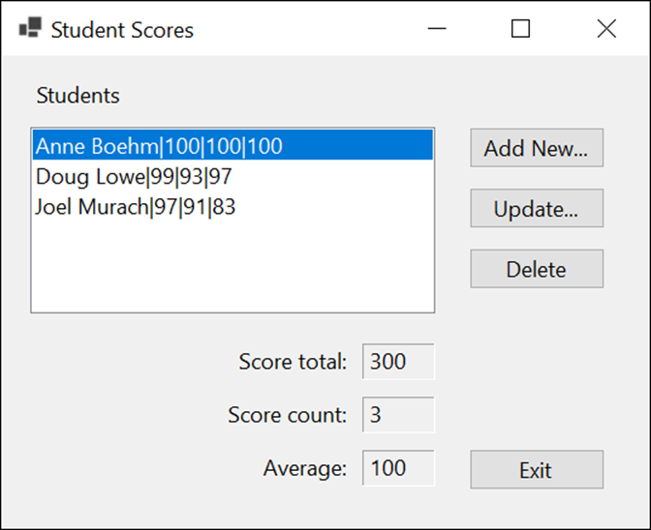
Project 4-1 Maintain student scores (text file)
Develop an application that lets the user maintain a list of student scores that are stored in a text file.

Slide 32
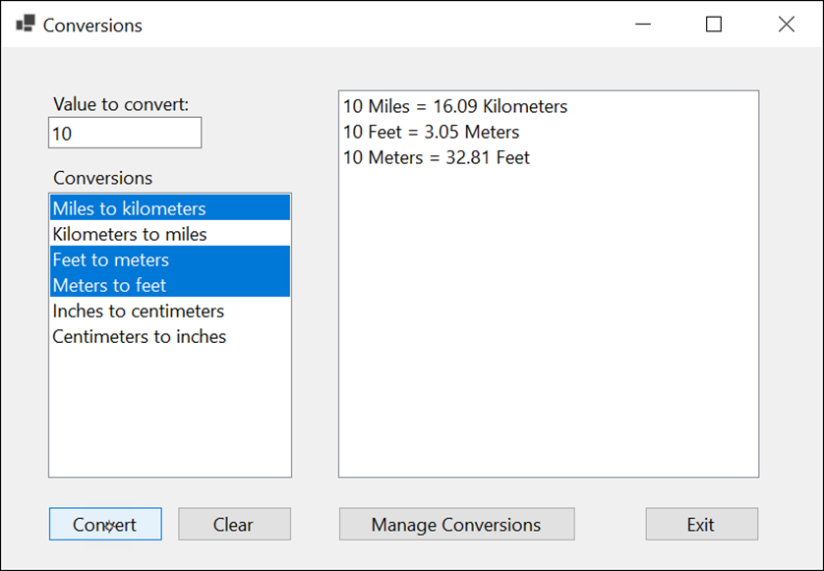
Project 4-2 Calculate conversions (part 1)
Develop an application that lets the user convert a value using conversions that are stored in a text file.

Slide 33
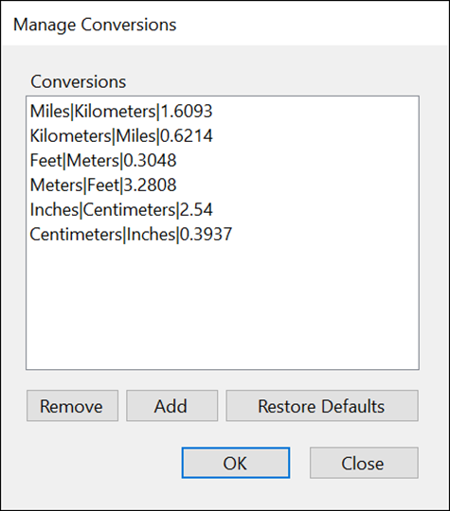
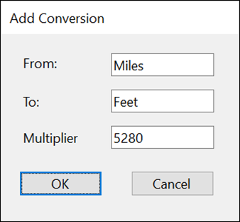
Project 4-2 Calculate conversions (part 2)
Develop forms that let the user add and remove conversions and restore the default conversions.

Slide 34
Objectives
Applied
Develop an application that requires the use of text or binary files.
Knowledge
Distinguish between a text file and a binary file.
Describe the use of FileStream, StreamReader, StreamWriter, BinaryReader, and BinaryWriter objects.
Describe two common types of I/O exceptions.
Distinguish between a using statement and a using declaration.

